Slide 1

Sentiment ANALYSIs on comments
Veenayak Sirohi and sushil dhoundiyal

Slide 2
Table of content
Introduction
Objective
Tools and Technology
Methodology
Future Scope
Conclusion
Challenges

Slide 3
Introduction
Sentiment analysis is the process of analyzing digital text to determine if the emotional tone of the message is positive, negative, or neutral.
The primary goal of sentiment analysis is to identify and understand the sentiment or emotional tone expressed in a piece of text, whether it is positive, negative, or neutral.

Slide 4
objective
Understanding Audience Sentiment
Brand Perception
Content Evaluation
Audience Engagement Analysis
Improving User Experience
Decision Making for Advertisers
Market Research and Trend Analysis

Slide 5
Tools and technology
Programming Languages: Python
Libraries: NLTK, Pandas, NumPy, Matplotlib, Scikit-learn
API: YouTube Data API (for comments retrieval)
Sentiment Analysis: NLTK's VADER Sentiment Intensity Analyzer
Machine Learning Model: Gaussian Naive Bayes

Slide 6
methodology
Data Collection: Use of YouTube Data API to collect comments associated with the video of interest.
Data Processing: Remove irrelevant information (e.g., URLs, special characters).
Handle missing or duplicate data points.
Standardize text (lowercase all text for consistency).
Tokenize the comments into individual words or phrases.
Address language-specific nuances and consider stemming or lemmatization.
Result and Reporting : Visualize the distribution of positive, negative, and neutral sentiments

Slide 7
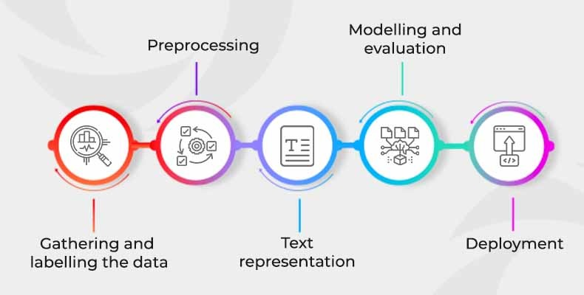
methodology

Slide 8
challenges
Sentiment analysis on YouTube comments comes with its own set of challenges due to the diverse and dynamic nature of the platform. Some of the key challenges include:
Variability in Language and Multilingual Language
Irony and Sarcasm
Mixed Sentiments
User Intent
Volume and Scale
Platform Changes
Validation and Ground Truth

Slide 9
Future scope
Advanced Techniques Explore advanced sentiment analysis techniques such as deep learning
Integration with AI: Integration with artificial intelligence for real-time sentiment monitoring
Multimodal Analysis: Integrating analysis of not just text but also images, emojis etc.
Consideration and Bias Mitigation: Future developments should focus on addressing biases present in sentiment analysis models to ensure fair and unbiased result.

Slide 10
conclusion
In conclusion, sentiment analysis on YouTube comments is a valuable tool for content creators, marketers, and researchers seeking to understand the emotional landscape of their audience.
By employing natural language processing techniques, this analysis allows for the classification of comments into positive, negative, or neutral sentiments, providing insights into viewer reactions and opinions.
As YouTube continues to be a dynamic platform for content and community interaction, sentiment analysis remains a crucial tool for enhancing content strategy, community engagement, and overall user experience.

Slide 11
THANKYOU
No questions please 😂

